Slide 1
MICROSOFT AZURE MACHINE LEARNING STUDIO IN REAL WORLD SPORTS
Global Azure Bootcamp Zagreb, Croatia 20180421

Slide 2
About us
Darko Katović Kineziološki Fakultet KIF
Miljenko Cvjetko - moljac Microsoft (Xamarin Inc.)

Slide 3
Intro – Motivation - Professional
_______________ (fill in some hype word here)
Options (Machine Learning, Data Science, Deep Learning, …)
Darko
___________________ does for living (teaching)
moljac
Works for Xamarin (Microsoft) on tools for apps, so logically writing apps makes him happy
Xamarin does tools for Mobile apps
Mobile apps w/o backend are toys

Slide 4
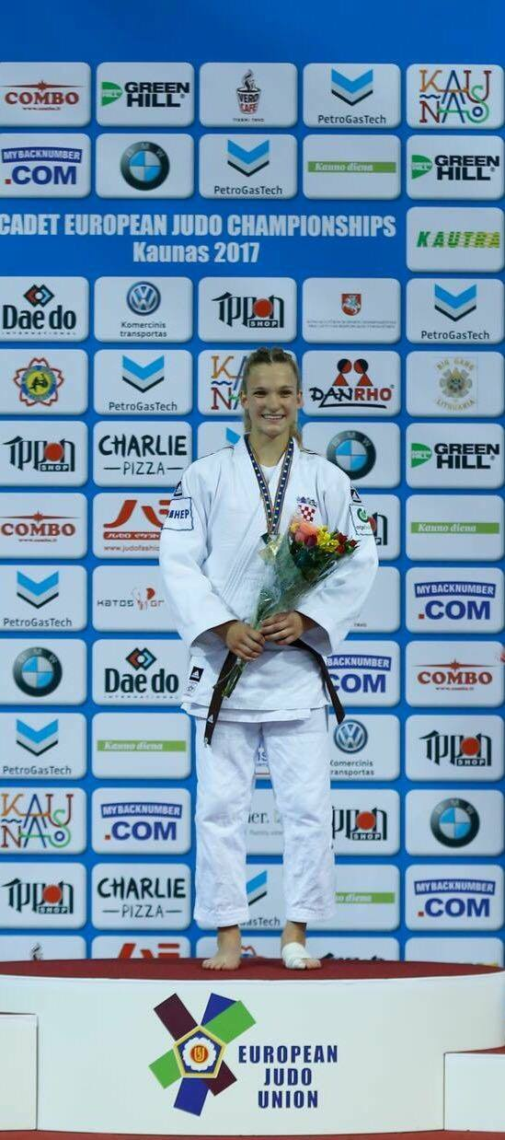
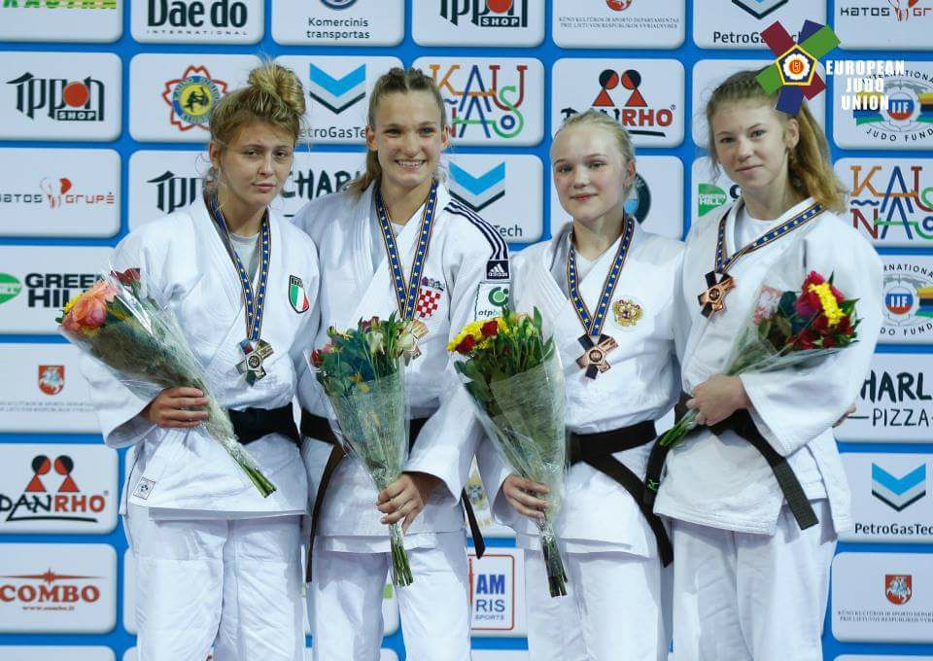
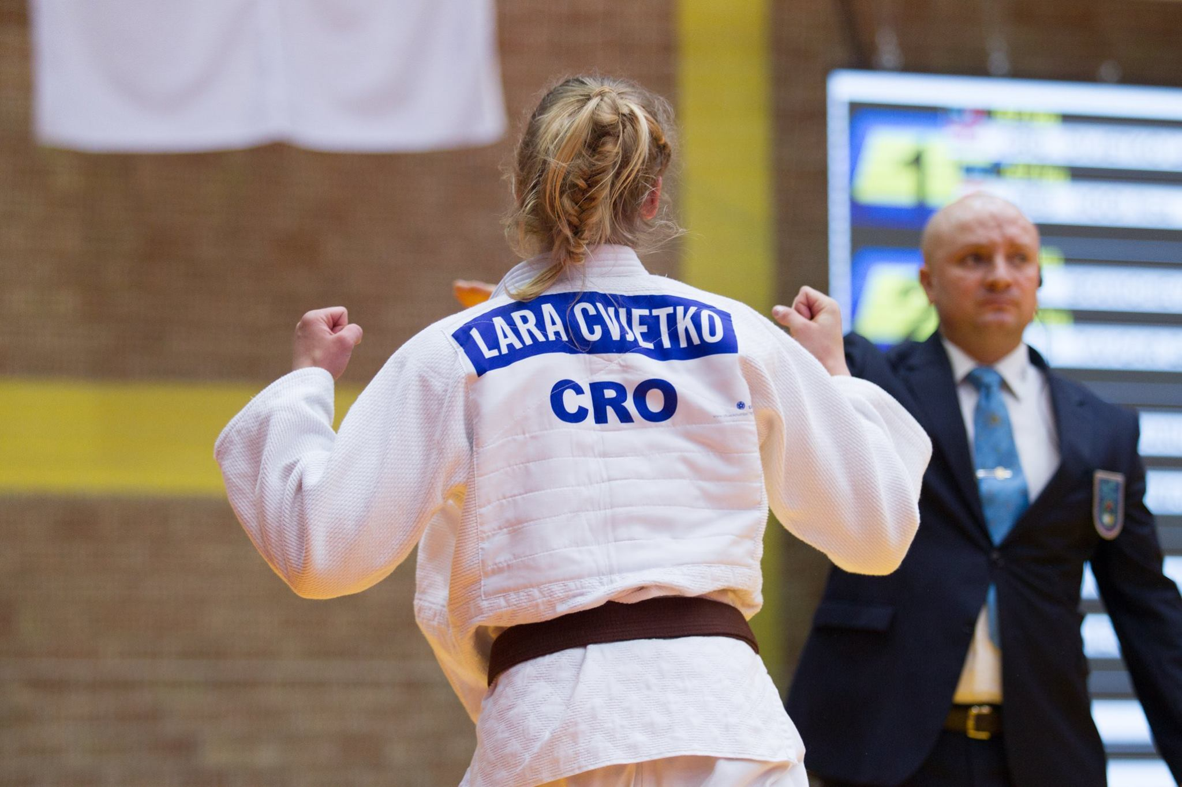
Intro – Motivation - Personal

Slide 5
Intro – What is ____________?
Data Science
Statistics
Big Data
Machine Learning
Deep Learning
Soft Computing
Fuzzy
Genetic
Data Wrangling/Munging
Data Storage
Data Manipulation
Data wrangling (munging), retrieval + storage
Big data
Data mining & machine learning
Statistics

Slide 6
Intro – What is ____________? Detailed
Machine Learning == Data Mining ??
Data Acquisition
Data Analysis (exploration)
Pattern / Rule finding
Modelling – Model building
Predictions / Decisions

Slide 7
Intro – How?
Data
Models
Business problem
Business Problem
Sales must reach == qualify for Olympics
Solutions - optimizations
Data
Sports – amount of data sufficient ?????
Models (read Math)
Complex (high number of parameters)
Non linear

Slide 8
Intro – How? Detailed
PROCESS
Business Problem
Goal
Optimizations (minimal energy or time)
Data
Collect data (activities, tests, competition)
Models (Math)
Complex
high number of parameters)
Non linear
PROCESS
Business Problem
Goal: Win, Olympics
Optimizations (no injuries, least effort / cost, ASAP,
Data
Data: Activities, Tests, Competition
Models (Math)
Complex
Fitness (Physiology), Motorics, Psychological
y = ax + b

Slide 9
Data Analysis and Modelling
Data
Collect
Store
Analyze
Modelling - Model Definition
Exact (if possible)
Train
Validate (score)
Use it – Explore or Deploy
Extend/Update it

Slide 10
Demo – Regression.Linear.WeightControl

Slide 11
Demo - Correlation.Basketball
Machine Learning Studio
help in real world applications

Slide 12
Demo
Machine Learning Studio
help in real world applications

Slide 13
Where are we?
Data
In development – application suite (xplat horizontally and vertically)
IoT
Mobile
Desktop
Server (ASP.net Core)
Collecting (from web and with the apps)
Models, Modelling
Testing, playing

Slide 14
Outro
Machine Learning Studio
help in real world applications

Slide 15
Q&A
Shoot

